Slide 1
Stata v R v Python
Syntax Comparisons

Slide 2
Stata v R v Python
Stata
Interpretative
Not object orientated
Command driven
Proprietary
Designed for social scientists, particularly economists
R
Interpretative
Object orientated
Function driven
Open source
Designed for statisticians
Python
Interpretative/Compiled
Object orientated
Function/dot notation driven
Open source
Designed for computer scientists

Slide 3
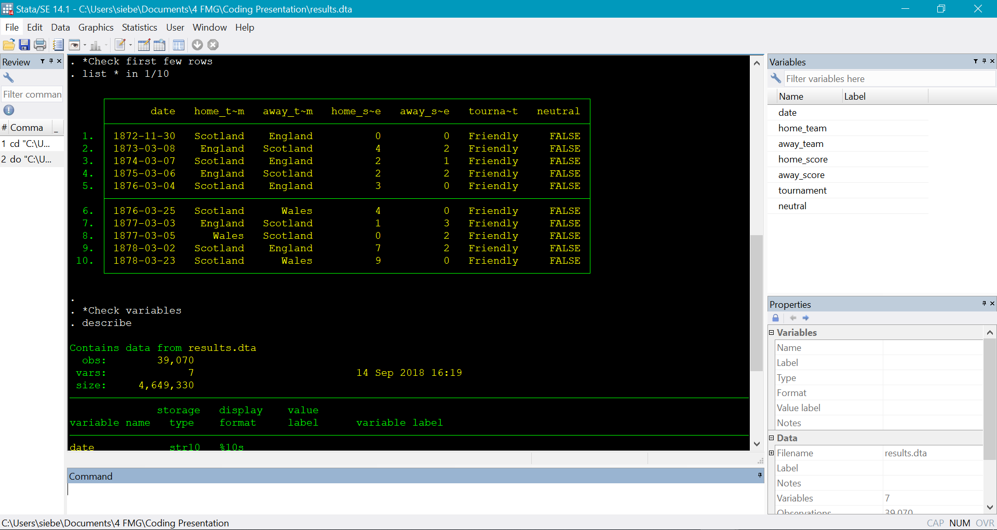
Stata Interface

Slide 4
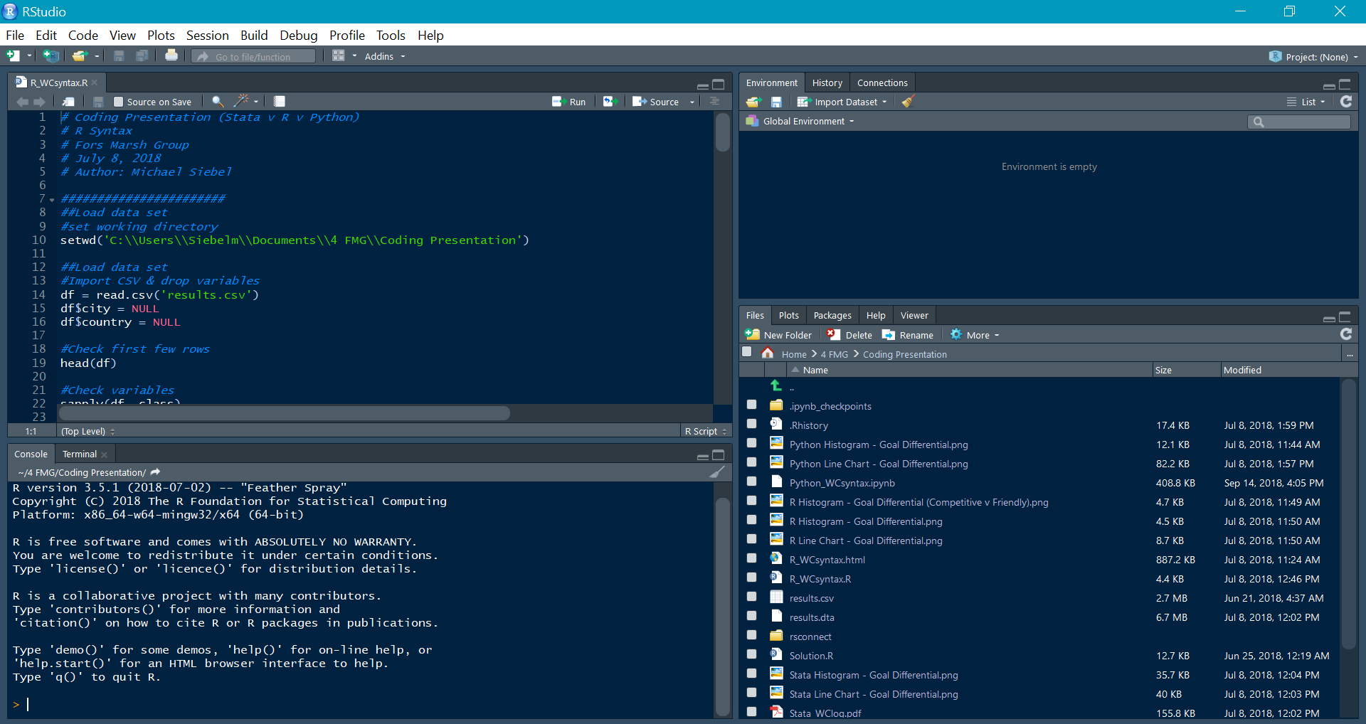
R Studio Interface

Slide 5
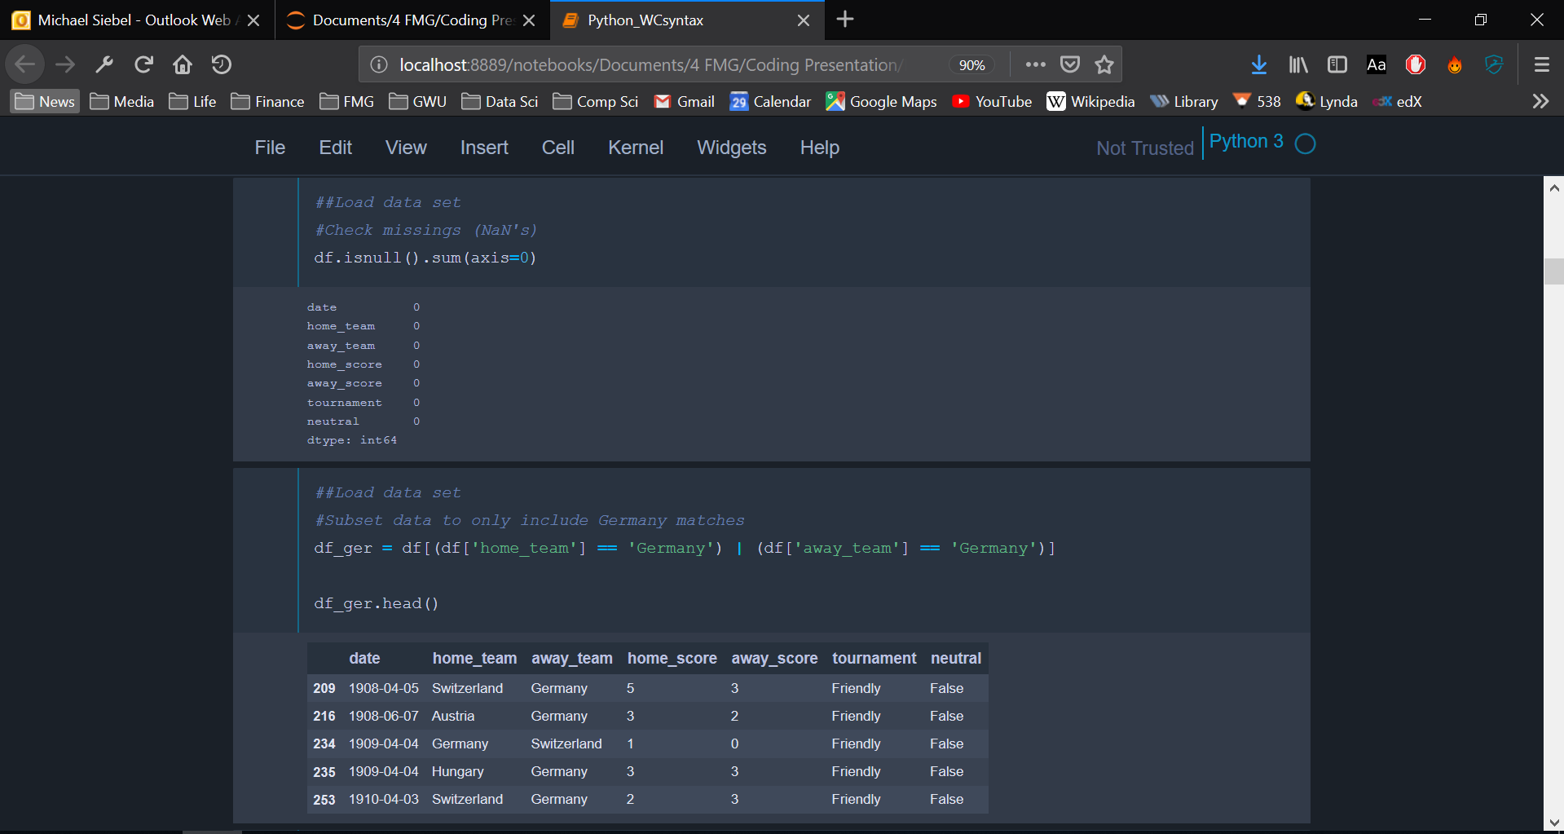
Jupyter Interface

Slide 6
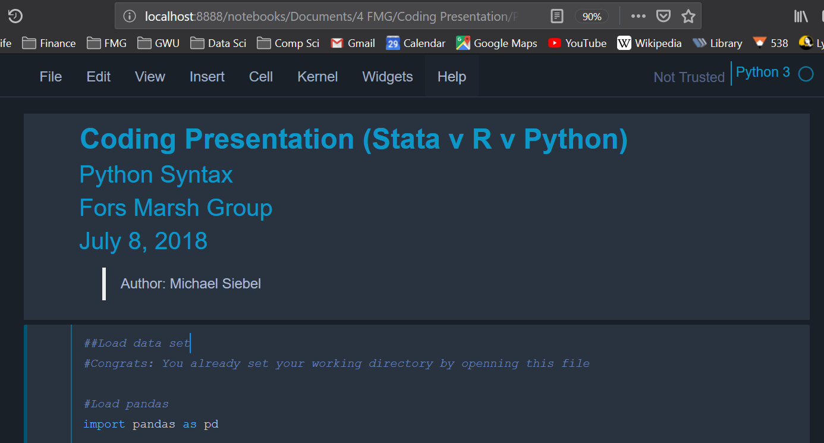
Jupyter Interface

Slide 7
Set Working Directory
Stata
*must have double quotes
R
*must have forward or double back slashes
Python

Slide 8
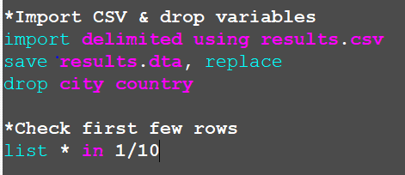
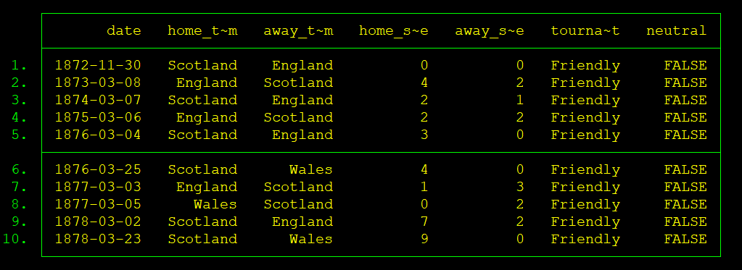
Loading Dataset
Stata
Runs commands immediately as opposed to saving as an object
in and if conditionals are commonly used

Slide 9
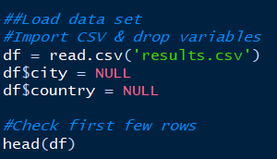
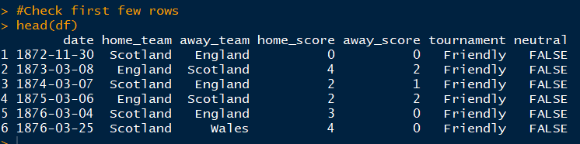
Loading Dataset
R
Dataframes are saved as an object which is used as a prefix for variables

Slide 10
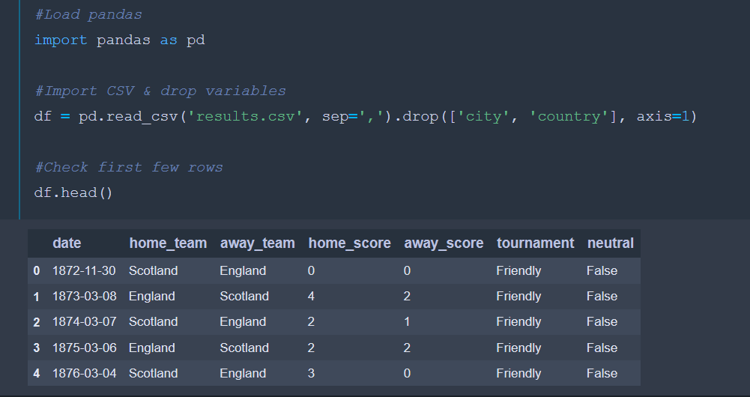
Loading Dataset
Python
Import packages
Save as objects
Use as objects in dot notation

Slide 11
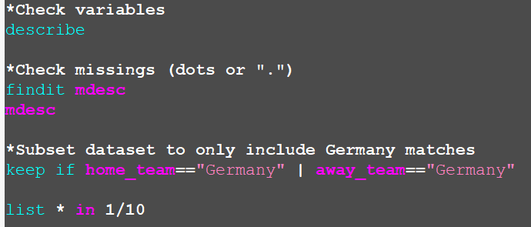
Check and Subset
Stata
Periods (.) are Stata’s missings
findit searches the web for commands
| and & are often used in conditionals

Slide 12
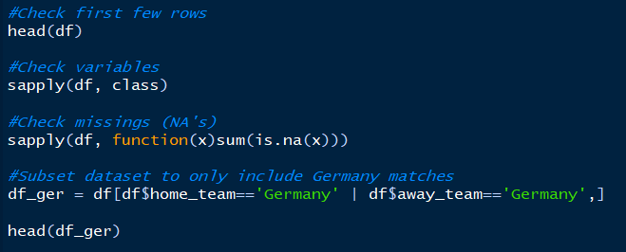
Check and Subset
R
R missings are NA’s
sapply is commonly used
Brackets define row and columns; here there is nothing after the common (no column defined) so all columns are used

Slide 13


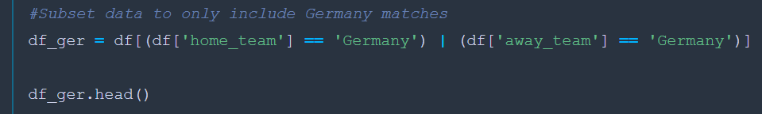
Check and Subset
Python
NaN’s are Python’s missings
Dataframe object is attached to functions using dot notation
Brackets and quotation marks define variables

Slide 14
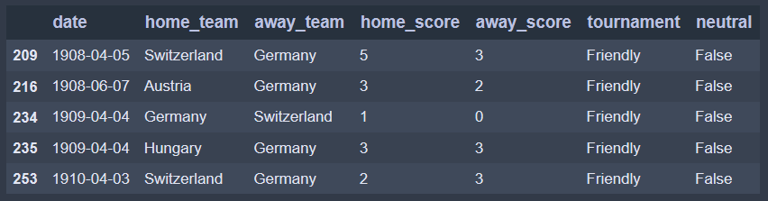
Conditional Recodes
Subsetted teams to only include Germany matches
Want to define goals scored and goals conceded
Need to understand if Germany was the home or away team

Slide 15
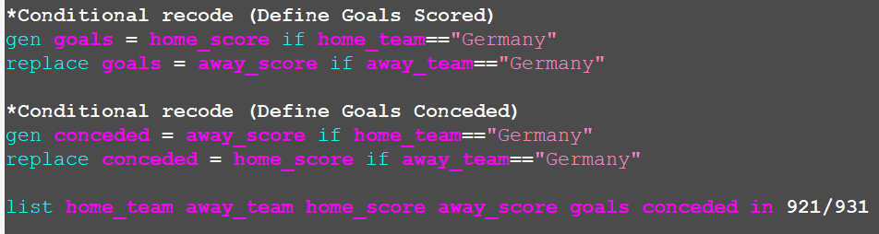
Conditional Recodes
Stata
Use gen and replace
Relies on if conditions

Slide 16
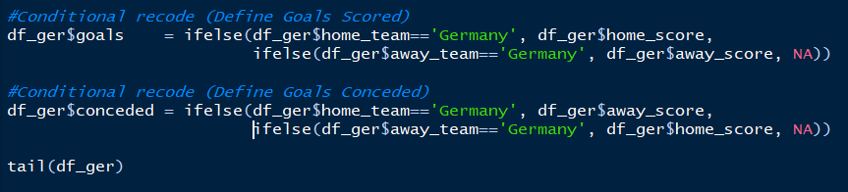
Conditional Recodes
R
R uses functions similar to excel
Ifelse() in R is equivalent to if() in excel
Could have coded similar to Stata based on bracket-based conditions

Slide 17
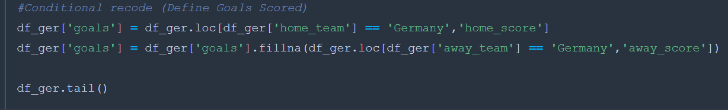
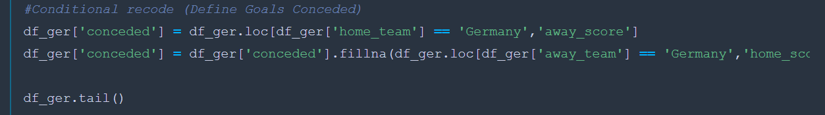
Conditional Recodes
Python
loc[] is a conditional that searches for certain values within a certain column
fillna() can be viewed as an append function

Slide 18
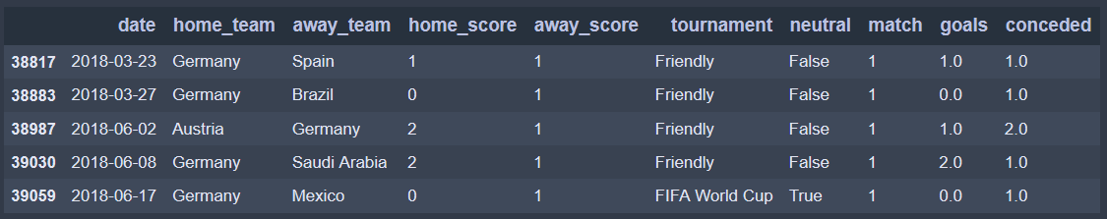
Simple Recode/Dummy Recode
Two more recodes to go
goals and conceded variables correspond to whether Germany was home or away
Simple subtraction can define a goal differential variable
Dummy recodes for Friendly v Competitive match can use logical syntax

Slide 19

Simple Recode
Stata
R
Python

Slide 20

Dummy Recode
Stata
R
Python

Slide 21
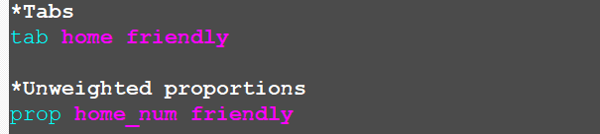
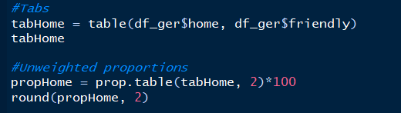
Tabs and Props
Stata
R

Slide 22
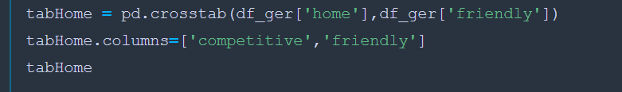
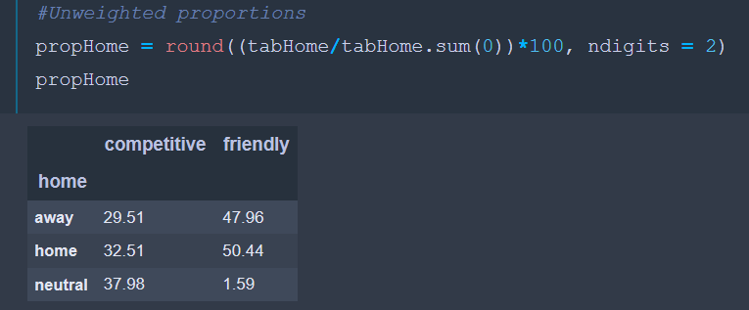
Tabs and Props
Python

Slide 23
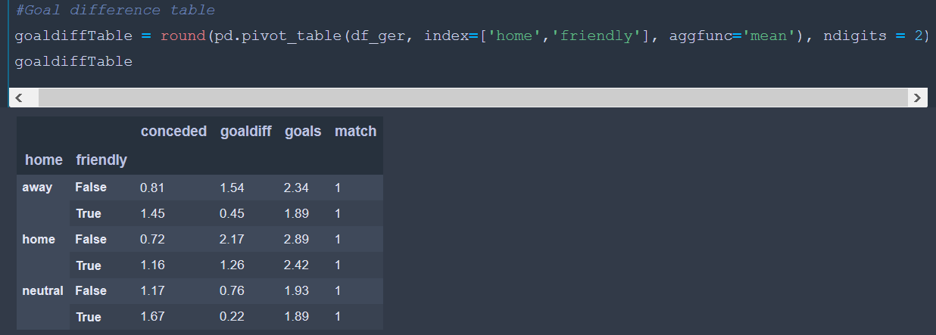
Pivot Table
Python
Can be done in one line

Slide 24
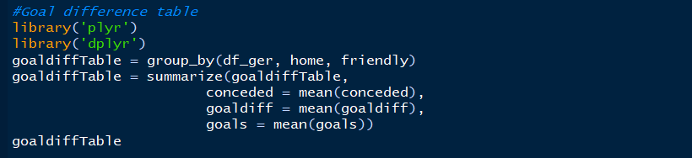
Pivot Table
R
Uses a group_by() and then summarize() function

Slide 25
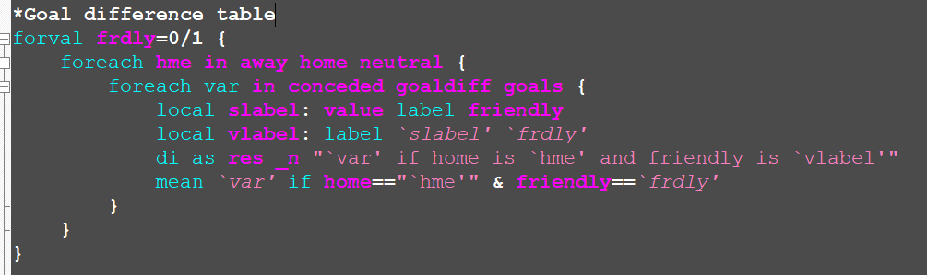
Pivot Table
Stata
No command
Needs complex loop

Slide 26
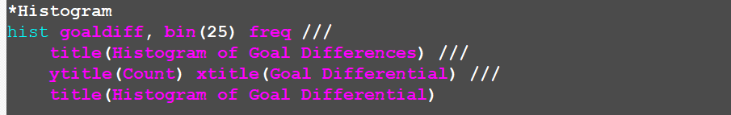
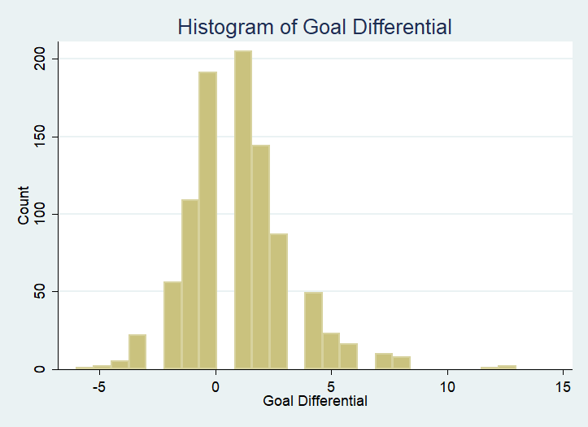
Histogram
Stata

Slide 27
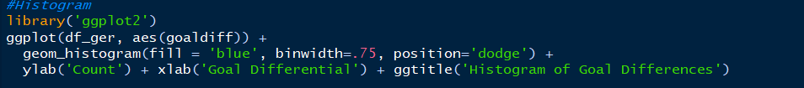
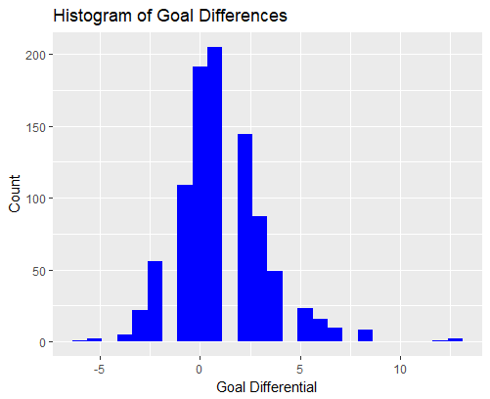
Histogram
R

Slide 28
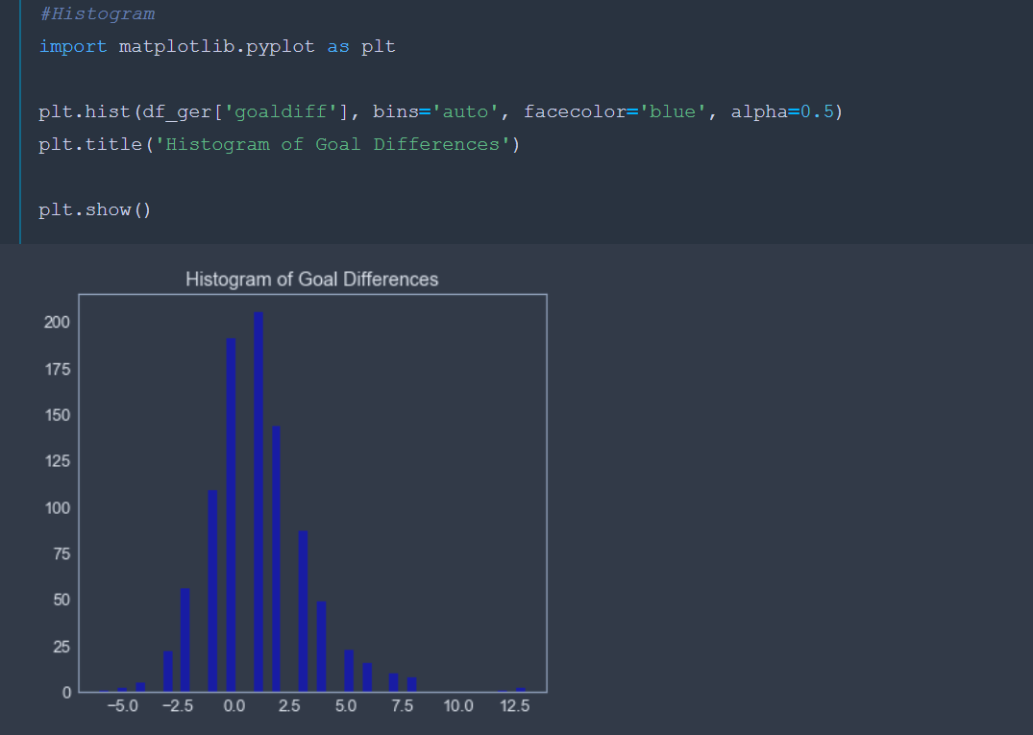
Histogram
Python

Slide 29
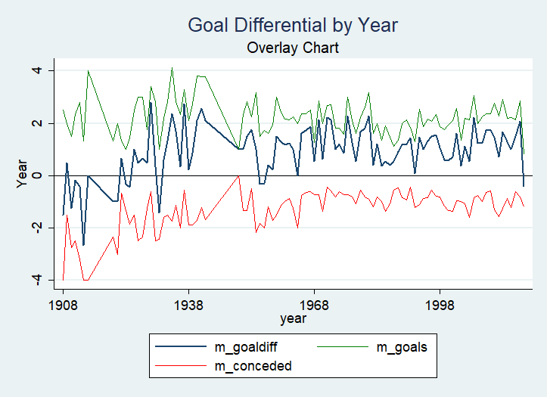
Line Graphs
Stata

Slide 30
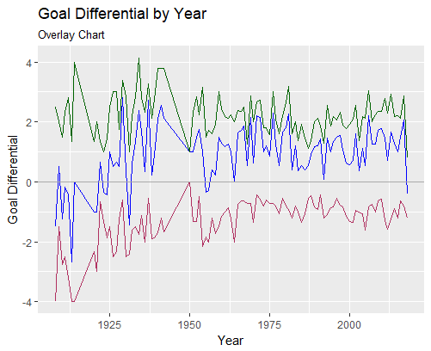
Line Graphs
R

Slide 31
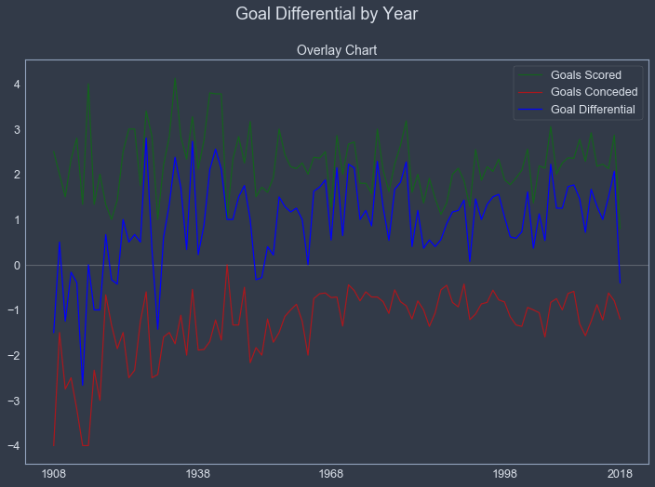
Line Graphs
Python

Slide 32
Thank You

